Slide 1

LA-CoNGA physics
Latin American alliance for Capacity buildiNG in Advanced physics
Reina Camacho Toro, Luis Nuñez y José Ocariz obo LA-CoNGA physics community
5th Colombian Meeting on High Energy Physics

Slide 2
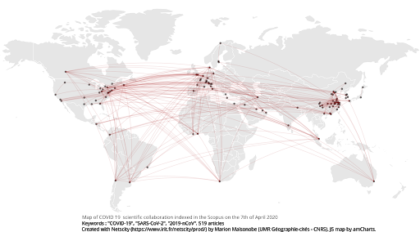
Scientific collaboration and education at a global scale
In the current information era, science and higher education are rapidly becoming globally distributed, collaborative and multidisciplinary
The university-research-society link is strengthen: knowledge generation, deployment application and transfer are taking place in the same physical and social context
Virtual Research and Learning Networks play a key role
A network of teachers and researchers to effectively work together on an infrastructure rich in information and communications technologies (ICT) where data, software tools, research facilities, teaching and information resources are seamlessly shared
https://www.irit.fr/netscity/prod/intro/

Slide 3

The importance of Virtual Research and Learning Networks
Three main objectives:
Accessibility: Each institution/group in the VRLN might not have all the resources nor the staff critical mass needed but together they are stronger
Modernization
Through the use of ICT and open educational resources, connectivity, acquisition of digital skills, use and development of new learning methods
All based in local capacity building for the sustainability of the projects
Internationalization
Train new generations within a collaborative international environment
Increasing the diversity in STEM

Slide 4
HECAP context in the Latin American region
A very summarized/simplified overview:
High energy, cosmology and astroparticle physics community/activities has grown in Latin America in the last decades
A series of initiatives have contributed to it (non exhaustive list)
The Pierre Auger observatory in Argentina
HELEN and EPLANET programs
Several other national, bi-national or multinational projects
In terms of human and research resources the HECAP development is nuanced and variable country-by-country (this impacts the training of the new generations)
Diversity of interests and skills developed (as we see in this forum!)
A young generation with much potential and eagerness to learn
Together we are stronger
HEP is one of the thematic areas of LA-CoNGA physics (another one is complex systems)

Slide 5
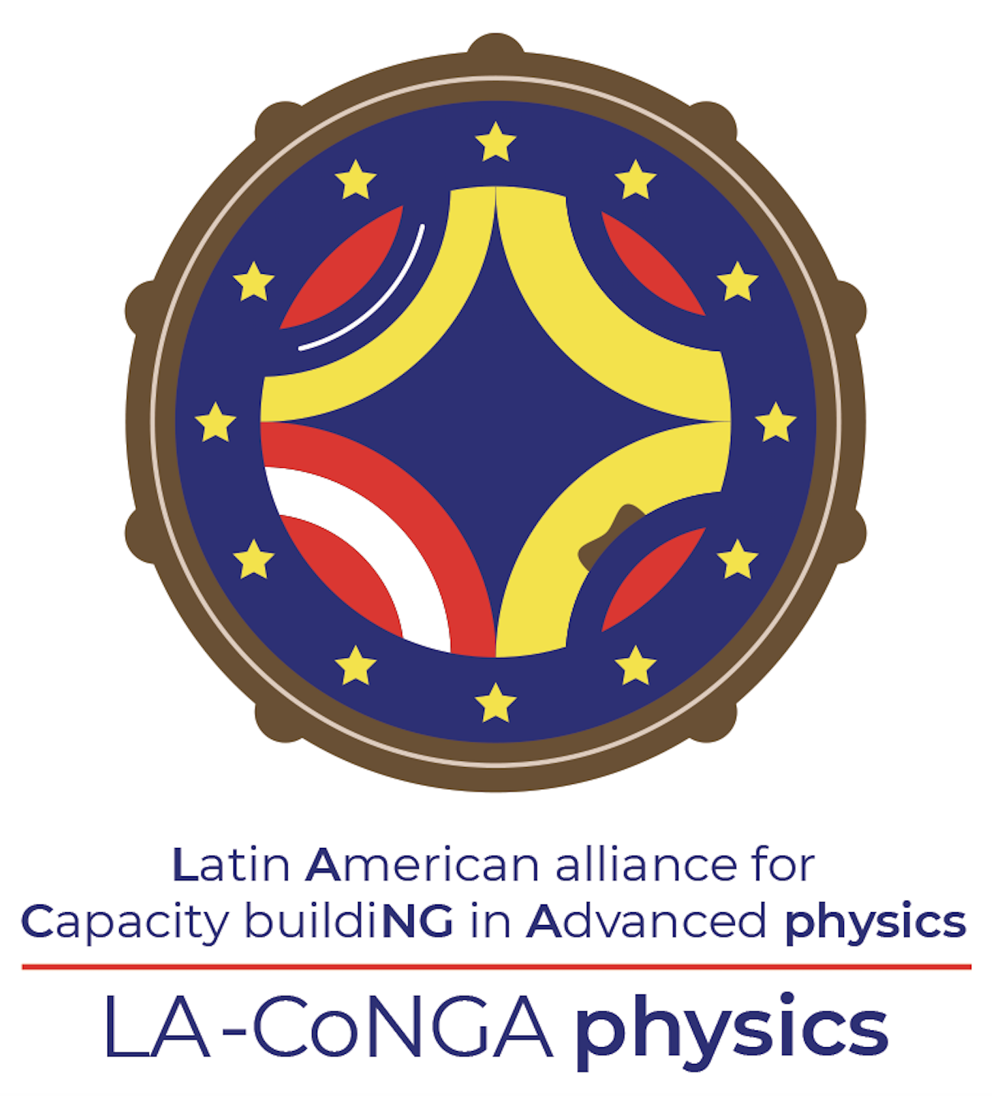
LA-CoNGA physics
An Erasmus+ project co-funded by the European Comission’s Education, Audiovisual and Culture Executive Agency
Responding to the strategy of the participant institutions and to the capacity building in higher education strategy promoted by the EU
A 3-years project. Officially started in January 2020
11 universities from Latin-America and Europe join efforts with other scientific (CERN, CNRS, DESY, ICTP, IRFU) and industrial partners to contribute to the modernisation, accesibility and internationalisation of the higher education in Colombia, Ecuador, Peru and Venezuela
A one year specialization in advanced physics, calibrated on the European curricular structure (i.e. 60 ECTS per year following the Bologna protocol), and integrated into the existing master programs of each of our 8 Latin American universities

Slide 6
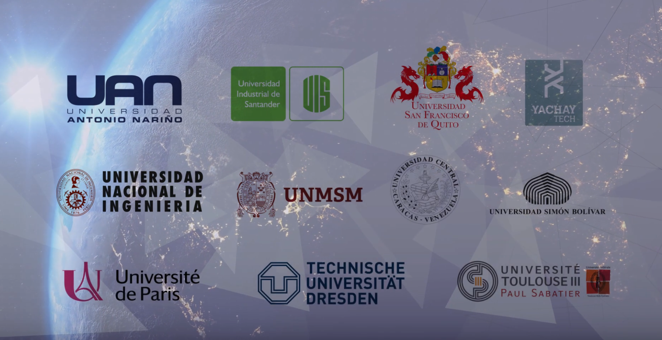
LA-CoNGA physics: the consortium

Slide 7
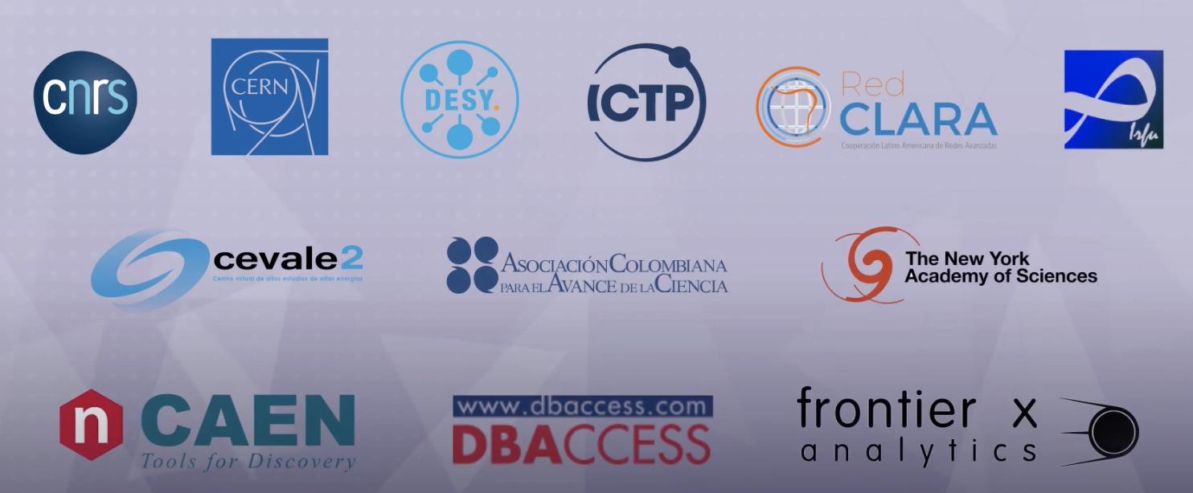
LA-CoNGA physics: the consortium
Scientific and industrial partners

Slide 8
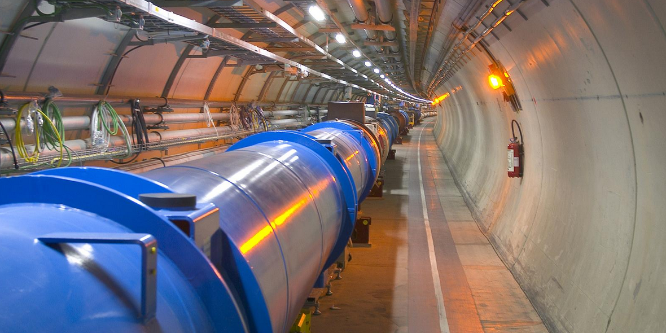
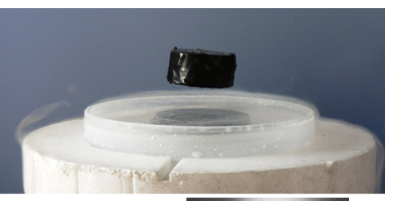
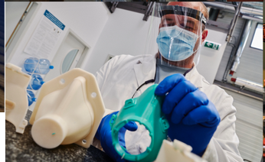
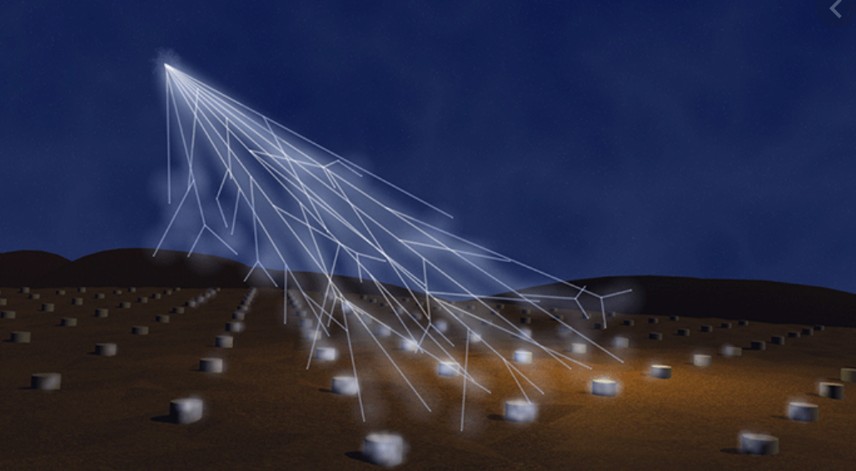
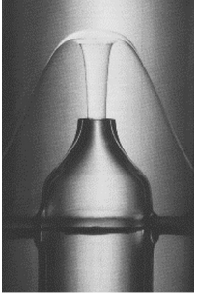
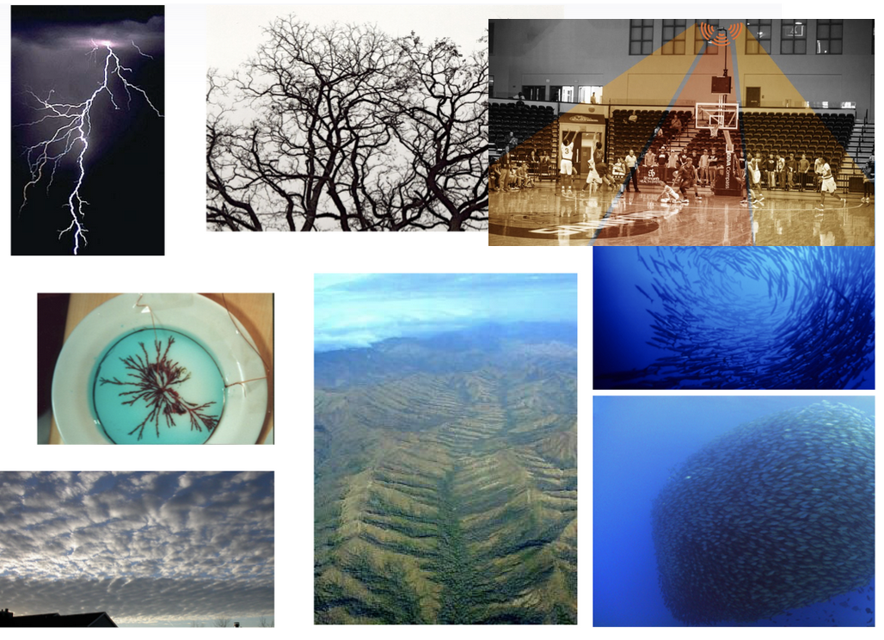
LA-CoNGA physics: two thematic areas
High Energy Physics
Answering fundamental questions about the universe
International collaborations
Knowledge transfer
Complex systems
Study and classification of matter states
Ubiquity of studied models
Networks and collective behavior
Highly interdisciplinary field

Slide 9
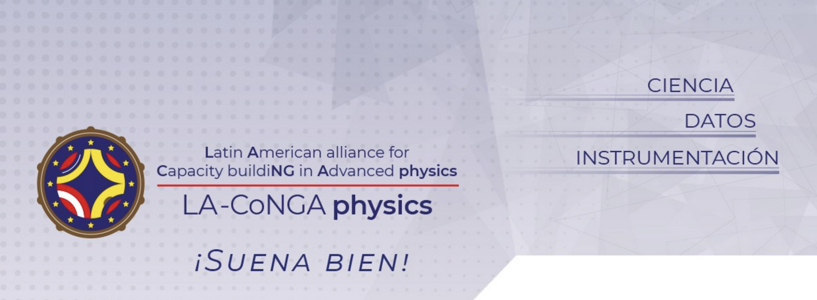
LA-CoNGA physics: three axis of competences

Slide 10
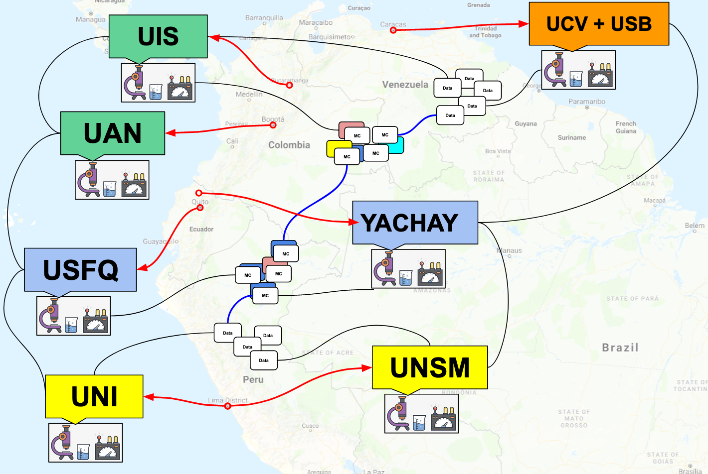
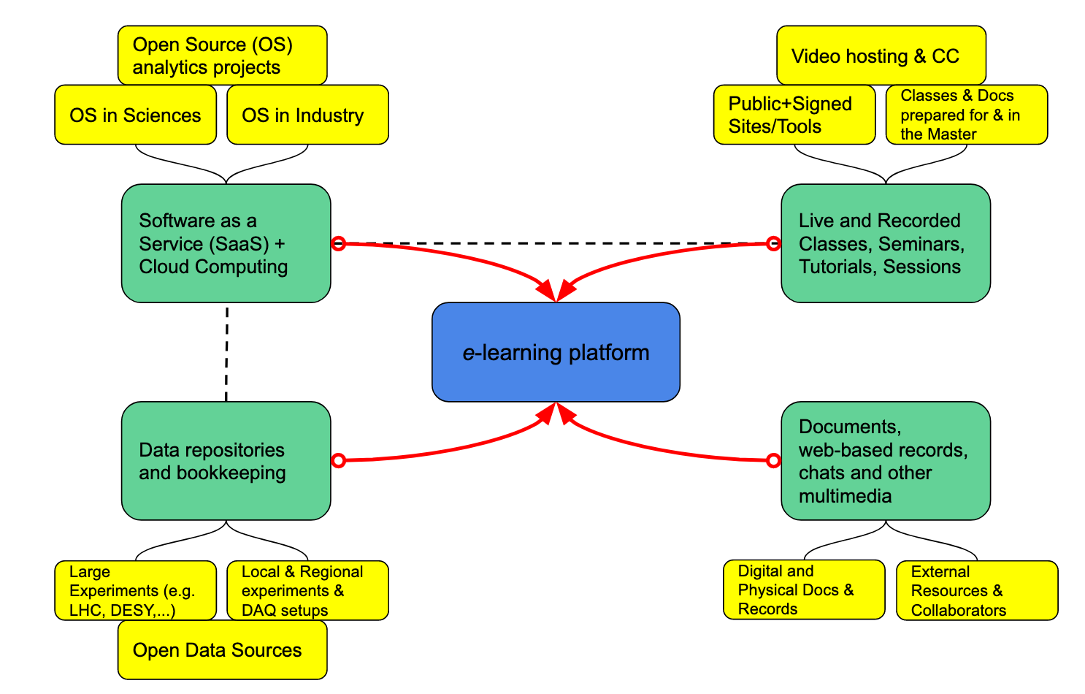
LA-CoNGA physics: methodology and platform
How do we want to do that:
An e-learning platform open access
Remote access to interconnected experimental facilities
Problem solving oriented curriculum, distributed in small blocks
Good practices of scientific reproducibility
Mobility program in Latin America and Europe for academic and industrial interships

Slide 11
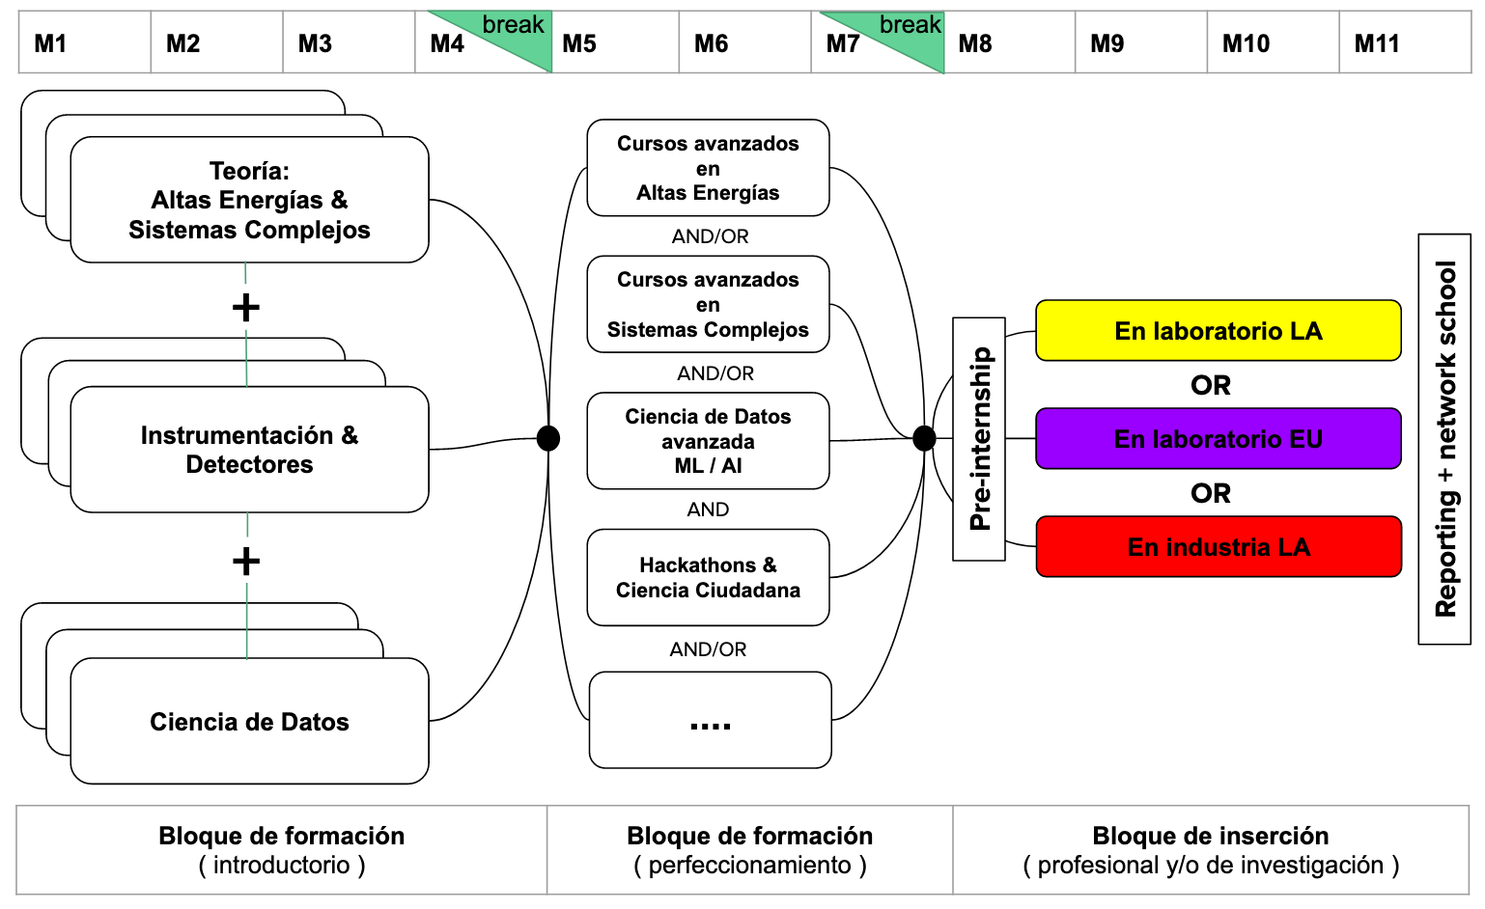
LA-CoNGA physics: implementation
LA-CoNGA physics community is working to start the first courses in January 2021

Slide 12
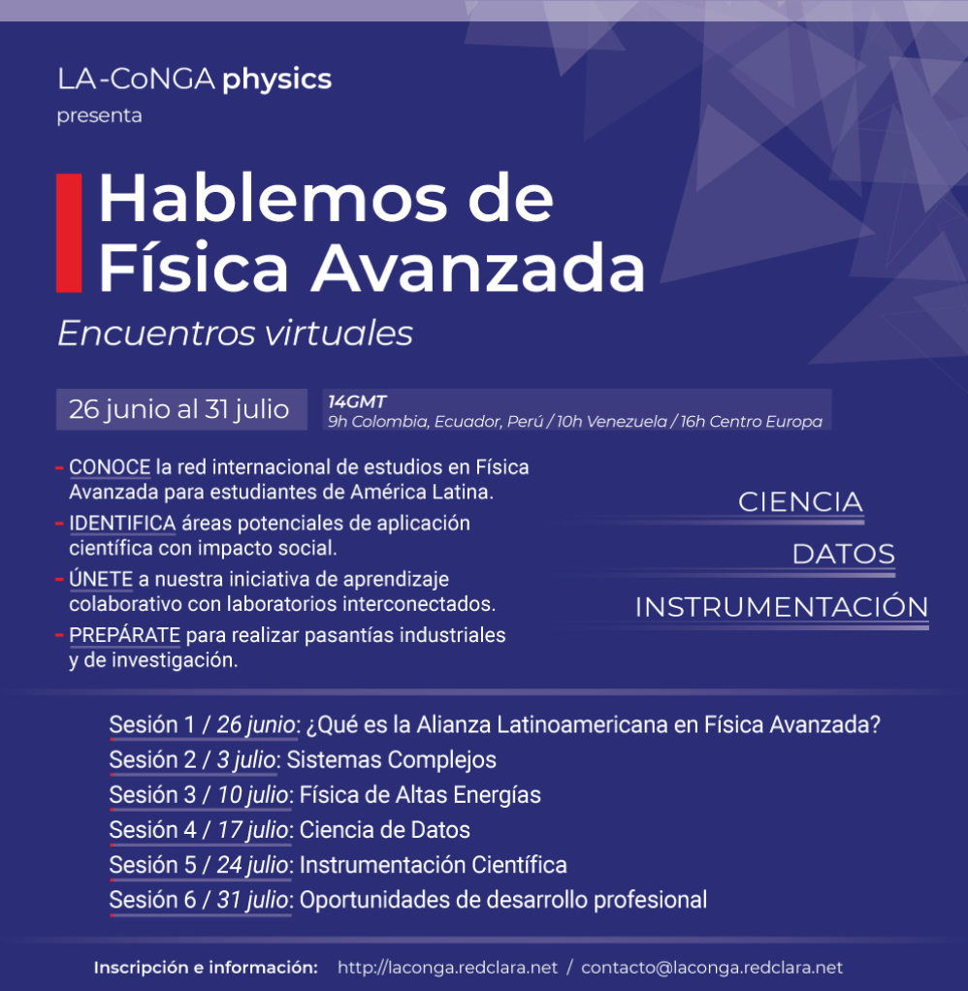
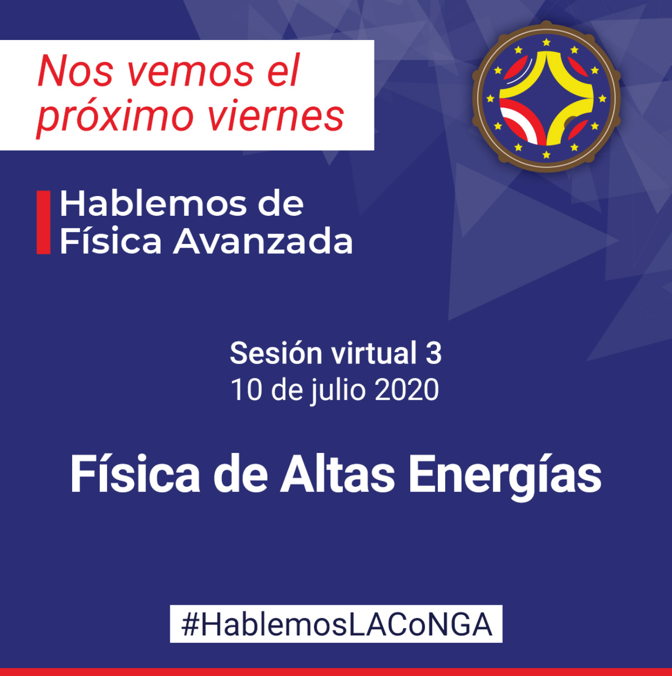
LA-CoNGA physics: #HablemosLAConGA
Officially launched two weeks ago with a serie of virtual sessions “Hablemos de Física Avanzada/Let’s talk about advanced physics”
Virtual sessions taking place every Friday for six weeks. Started on June 26th!
More than 200 attendees in the two first events
More info about the next sessions at: http://laconga.redclara.net/blog/

Slide 13
LA-CoNGA physics: our values/our vision
We strengthen a sustainable, dynamic, collaborative, interconnected and diverse virtual research and learning network of Latin American and European researchers in advanced physics
With close ties to the productive sector, which leads the development of science and technology in the region
Contributing to the modernization, accessibility and internationalization of higher education systems in the region
Using of technology in educational environments to enhance learning
We envision similar experiences in other disciplines

Slide 14
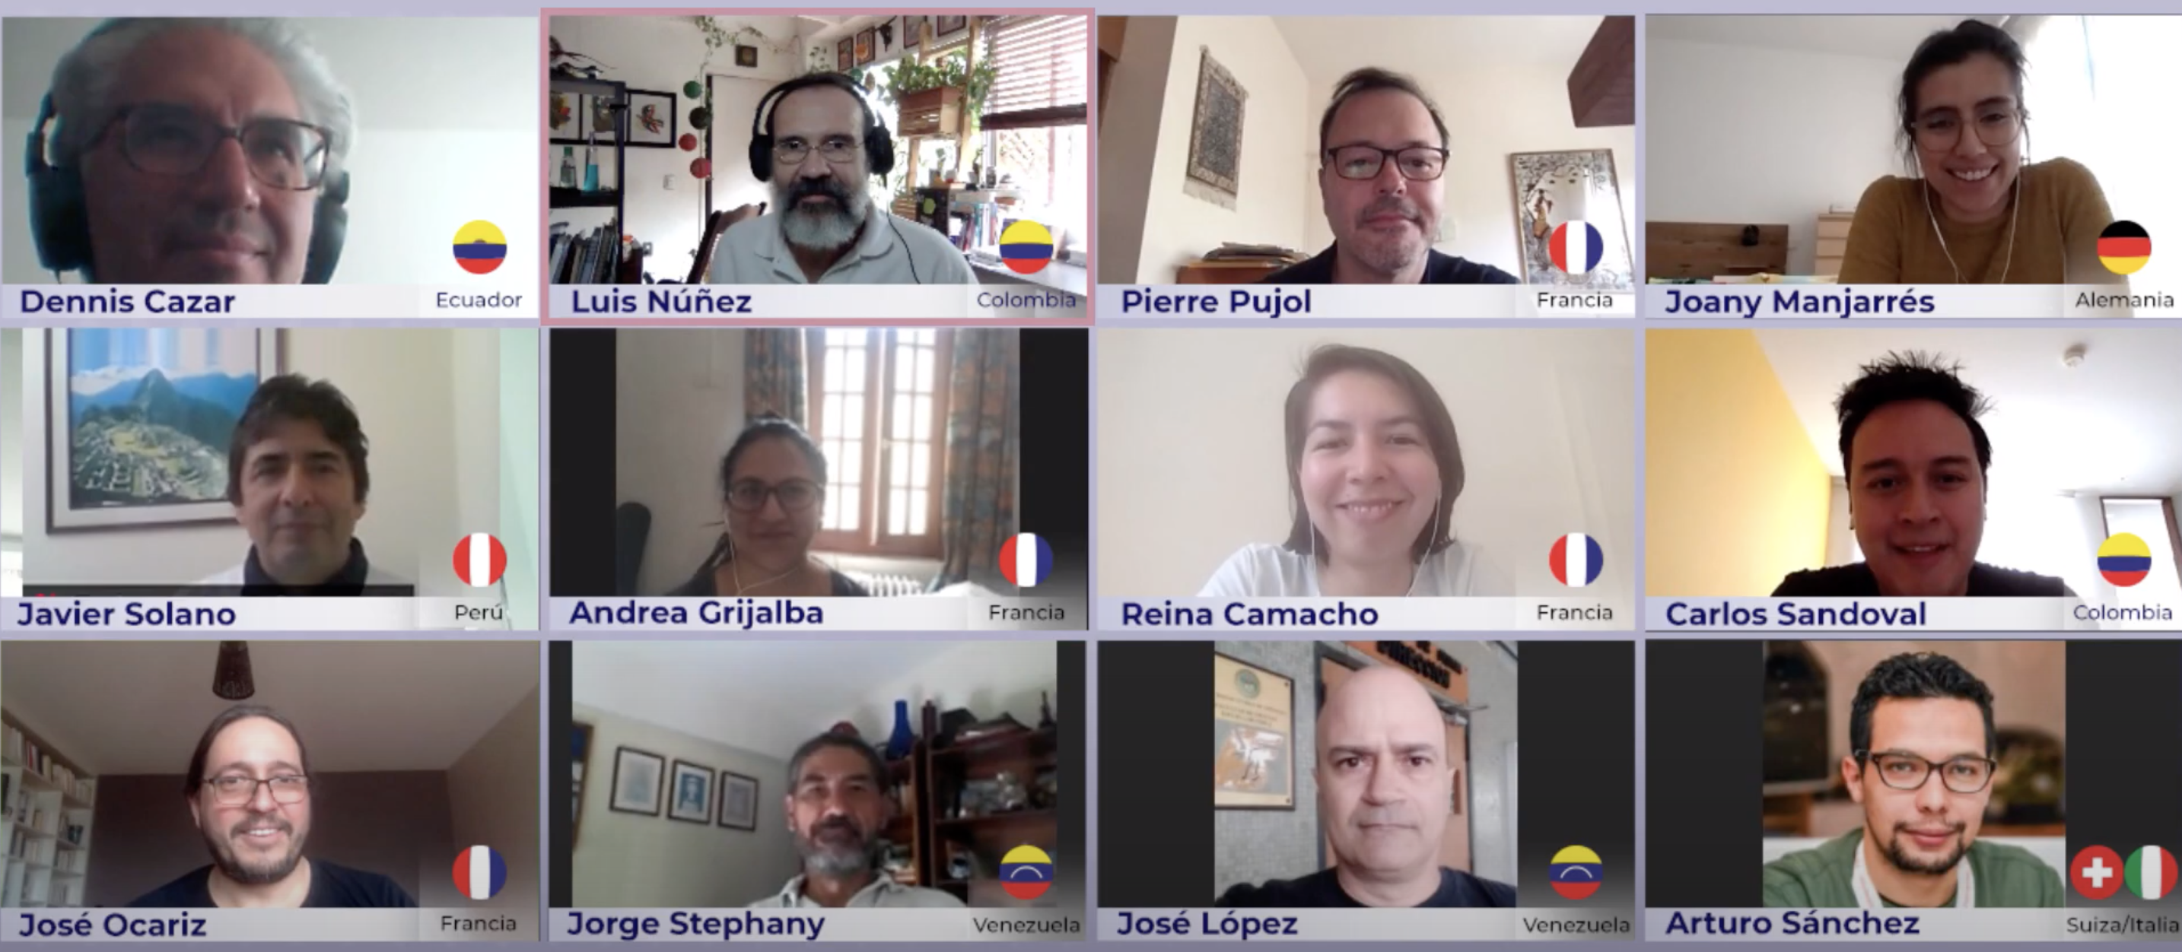
Thanks!
Missing some of the community members in the picture!
Invite you to check our launching video and our website to get more info about the project and the team!

